Slide 1


BRAIN COMPUTER INTERFACE FOR LEARNING ASSISTANCE
VELALAR COLLEGE OF ENGINEERING AND TECHNOLOGY
Supervisor
Project students
MS. SHARMILA .M AP/BME
MUTHU YOGESH .B - 19BMR046
RANJITH KUMAR.P - 19BMR060
SNEHA .R - 19BMR070

Slide 2
BACKGROUND
Attention-related problems while learning can manifest in a variety of ways and can have a negative impact on an individual's ability to learn and retain information. Here are a few examples of attention-related problems that can occur while learning:
Inattention: This refers to difficulty paying attention or staying focused on the task at hand. This can lead to a lack of understanding and retention of the material being learned.
Distractibility: This refers to the tendency to be easily distracted by external or internal stimuli. This can lead to a lack of concentration and the inability to stay on task.
Hyperactivity: This refers to excessive physical activity or restlessness, which can make it difficult to sit still and focus on the task at hand.
Impulsivity: This refers to a tendency to act on impulse without thinking things through, which can lead to poor decision-making and difficulty following instructions.
Memory problems: This refers to difficulties remembering information that was previously learned.

Slide 3
LITERATURE SURVEY
S.NO | AUTHOR | PUBLISHED YEAR | USED TECHNIQUES
1. | Mitra Alirezaei, Sepideh Hajipour Sardouie | Detection of Human Attention Using EEG Signals 2017 | In this study, a brand new protocol of brain signal recording is proposed in order to classify human attention in educational environments.The signals were classified using KNN (K=9), c-SVM, LDA, and Bayesian classifiers and the results were compared for each of the subjects individually.
2. | Mahnaz Arvaneh, Ian H. Robertson and Tomas E. Ward | A P300-Based Brain-Computer Interface for Improving Attention 2019 | This paper, suggests that the proposed neurofeedback training tool and P300 is a promising tool for improving attention particularly for those who are at risk of attention deficiency.

Slide 4
CONTINUE
S.NO | AUTHOR | PUBLISHED YEAR | USED TECHNIQUES
3. | Jonghyuk Park, Jonghun Park, Dongmin Shin and Yerim Choi | A BCI Based Alerting System for Attention Recovery of UAV Operators 2021 | The proposed system, based on BCI, is composed of inattention detection to automatically detect inattention of a UAV operator. To achieve this, we utilize the operator’s electroencephalogram (EEG) signal that is the recording of human brain.
4. | Muhammad Bilal, Muhammad Marouf, Safdar Rizvi, Fatima Bashir, Muhammad Shahzad, Jawad Ahmed Bhutta, | EEG-Based BCI for Attention Assessment in E-Learning Environment using SVM 2022 | This paper proposed recognition of attention level. EEG signals were extracted using the non-invasive device and processed data for noise removal through the Finite Impulse Response (FIR) filter. A machine learning approach has been used for the classification of data.

Slide 5
OBJECTIVE
The main objective of our project is to
Develop a BCI(Brain Computer Interface) system that can detect and track the attention level of learners and use this information to adapt the learning content and teaching methods to improve the overall learning experience.

Slide 6
EXISTING METHOD
There are several existing methods for monitoring learning attention and improving learning efficiency with attention, including:
Self-reflection: Encouraging learners to reflect on their own learning process and provide feedback on what is working well and what is not.
Formative assessment: Using formative assessments, such as quizzes and practice problems
Adaptive learning: Using technology to create personalized learning experiences that adapt to the learner's needs and progress.
Collaborative learning: Encouraging learners to work together to solve problems and share knowledge.
Active learning: Encouraging learners to actively engage with the material, such as through hands-on activities, discussions, and problem-solving, rather than passively listening to lectures.

Slide 7
PROPOSED METHOD
The proposed method consists of Brain-computer interface (BCI)
BCI technology is used to detect and track the attention level of learners and adapt the learning content and teaching methods to improve the overall learning experience.
BCI technology can be implemented with Electroencephalogram (EEG) signals of the subjects.
The proposed method helps in improving the learning capability with the help of BCI.

Slide 8
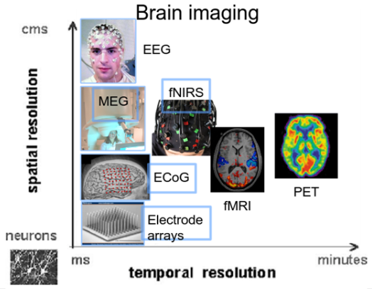
Brain Computer Interface
A Brain-Computer Interface (BCI) is a system that enables communication between a human brain and an external device or computer.
This is achieved by measuring brain activity, such as Electrical or Magnetic signals, and using this information to control or interact with external devices or software.

Slide 9
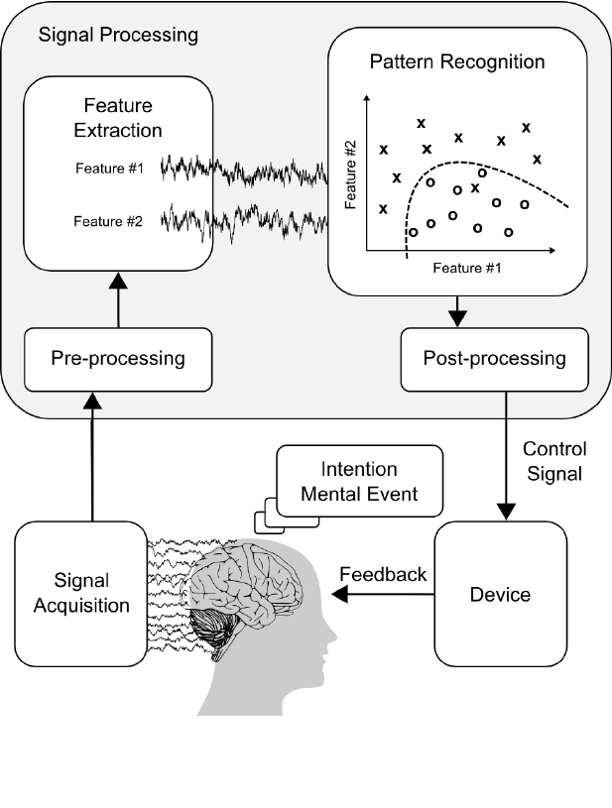
Brain Computer Interface
BCIs can be classified into two main categories:
Invasive : BCIs involve the implantation of electrodes directly into the brain
Non-invasive : BCIs use electrodes on the scalp to measure brain activity.

Slide 10
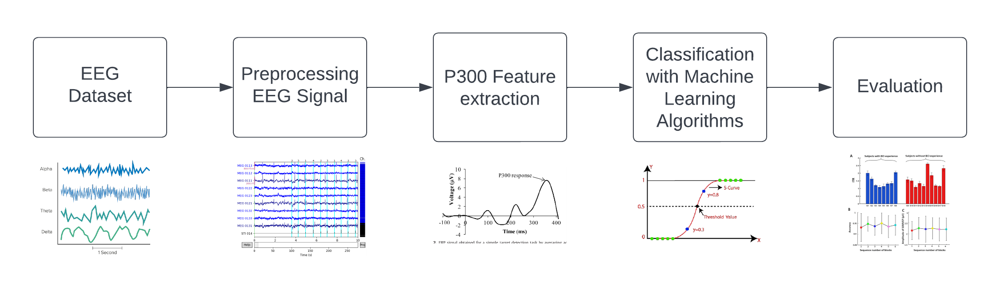
Brain Computer Interface – Block Diagram of the proposed work

Slide 11
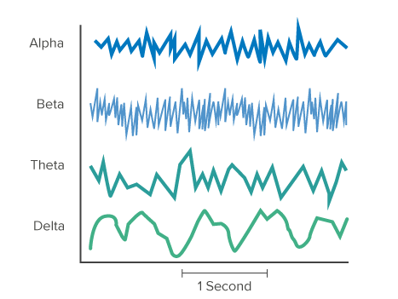
Brain Computer Interface - Dataset
Building a Brain-Computer Interface (BCI) involves several steps
Dataset: The first step is to select proper EEG dataset which consists of EEG Data from participants while they perform attention-related tasks, such as visual or auditory oddball paradigm, or a P300 speller task. The EEG data is typically collected using an EEG cap with electrodes placed on the scalp. It is important to ensure that the data is of high quality and free of artifacts.
The DEAP dataset 32 participants 41 min long video (access) http://www.eecs.qmul.ac.uk/mmv/datasets/deap/
EEG data for mental attention 34 files ----mat https://www.kaggle.com/datasets/inancigdem/eeg-data-for-mental-attention-state-detection

Slide 12
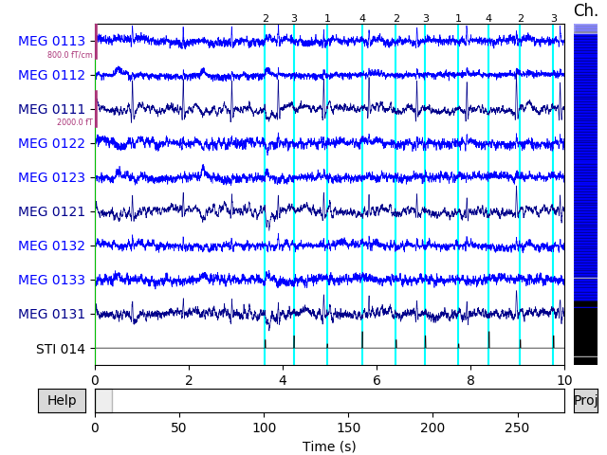
Pre-Processing - BCI
Preprocessing : preprocess the data to remove any noise or artifacts that may affect the BCI performance.
This may include ,
Filtering the data,
Removing bad channels
Epoching the data into segments that correspond to specific stimuli or events.

Slide 13
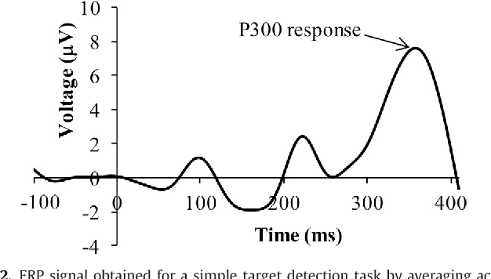
Feature Extraction
Feature Extraction : After preprocessing, the next step is to extract features from the EEG data that are relevant for attention detection.
In our project we are using the P300 waveform, which is a positive-going waveform that typically occurs around 300 milliseconds after a target stimulus is presented among a series of non-target stimuli.

Slide 14
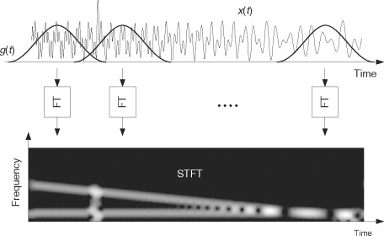
P-300 Feature Extraction
There are several techniques that can be used for feature extraction, including time-domain, frequency-domain and time-frequency domain methods. Here are a few examples:
Time-domain methods: These methods involve extracting features from the EEG data in the time-domain, such as the peak amplitude and latency of the P300 waveform. The peak amplitude and latency can be used to classify the attention level of the participant.
Short Time Fourier Transform

Slide 15
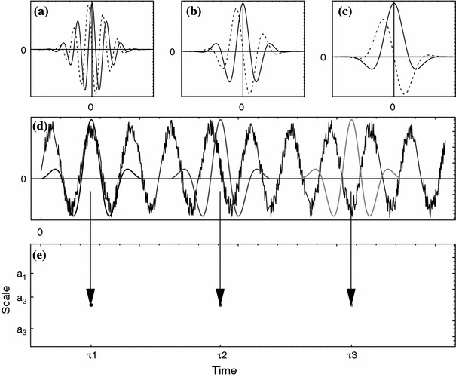
P-300 Feature Extraction - continue
Frequency-domain methods: These methods involve transforming the EEG data into the frequency-domain using techniques such as the Fourier transform. Features such as the power or the coherence in specific frequency bands can be extracted and used to classify the attention level of the participant.
Time-frequency domain methods: These methods involve analyzing the EEG data in both the time and frequency domains. Techniques such as the Short-Time Fourier Transform (STFT) or the Morlet wavelet transform can be used to extract time-frequency features such as the power or the coherence in specific frequency bands, and time intervals.
Morlet Wavelet Transform

Slide 16
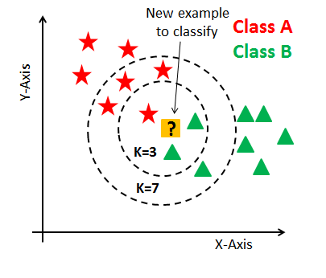
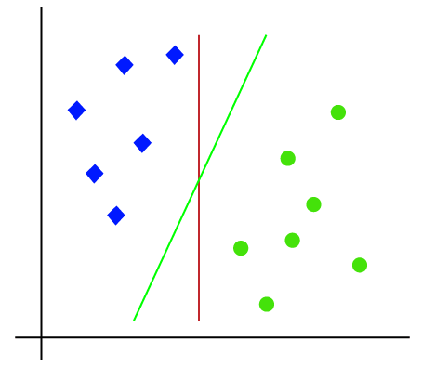
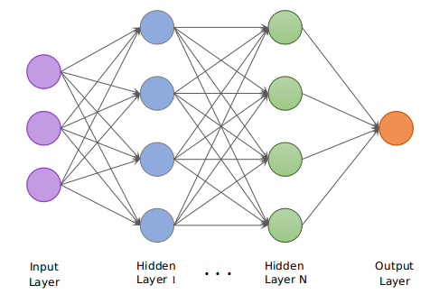
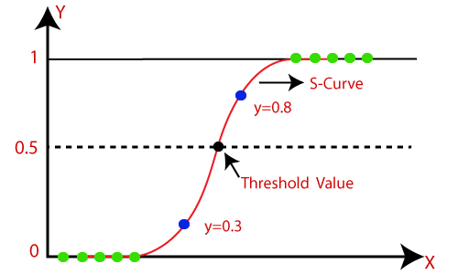
Model Training - BCI
Model Training: Next, a machine learning model is trained on the extracted features to classify the attention level of the participant.
Common models used in BCI include,
Linear discriminant analysis
Decision trees
support vector machines.
Logistic Regression
Convolution Neural Network
K-Nearest Neighbour
KNN
SVM
CNN
LOGISTIC REGRESSION

Slide 17
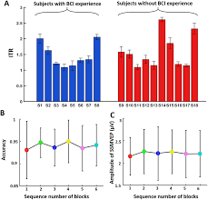
Evaluation - BCI
Evaluation : Finally, the performance of the BCI system is evaluated using appropriate evaluation metrics, such as
Accuracy plot of the BCI System
Considering the specific use-case for which the BCI is developed.

Slide 18
TOOLS REQUIRED
EEG – ERP Signal Dataset
Filter Design Algorithms
Python 3.11
Python Module
Tensorflow - Keras
PYEEG
MNE
SPKit
Matplotlib
SciPy
Signal Processing Tools
STFT
Morlet wavelet transform
ML algorithm
Logistic Regression
Convolution Neural Network

Slide 19
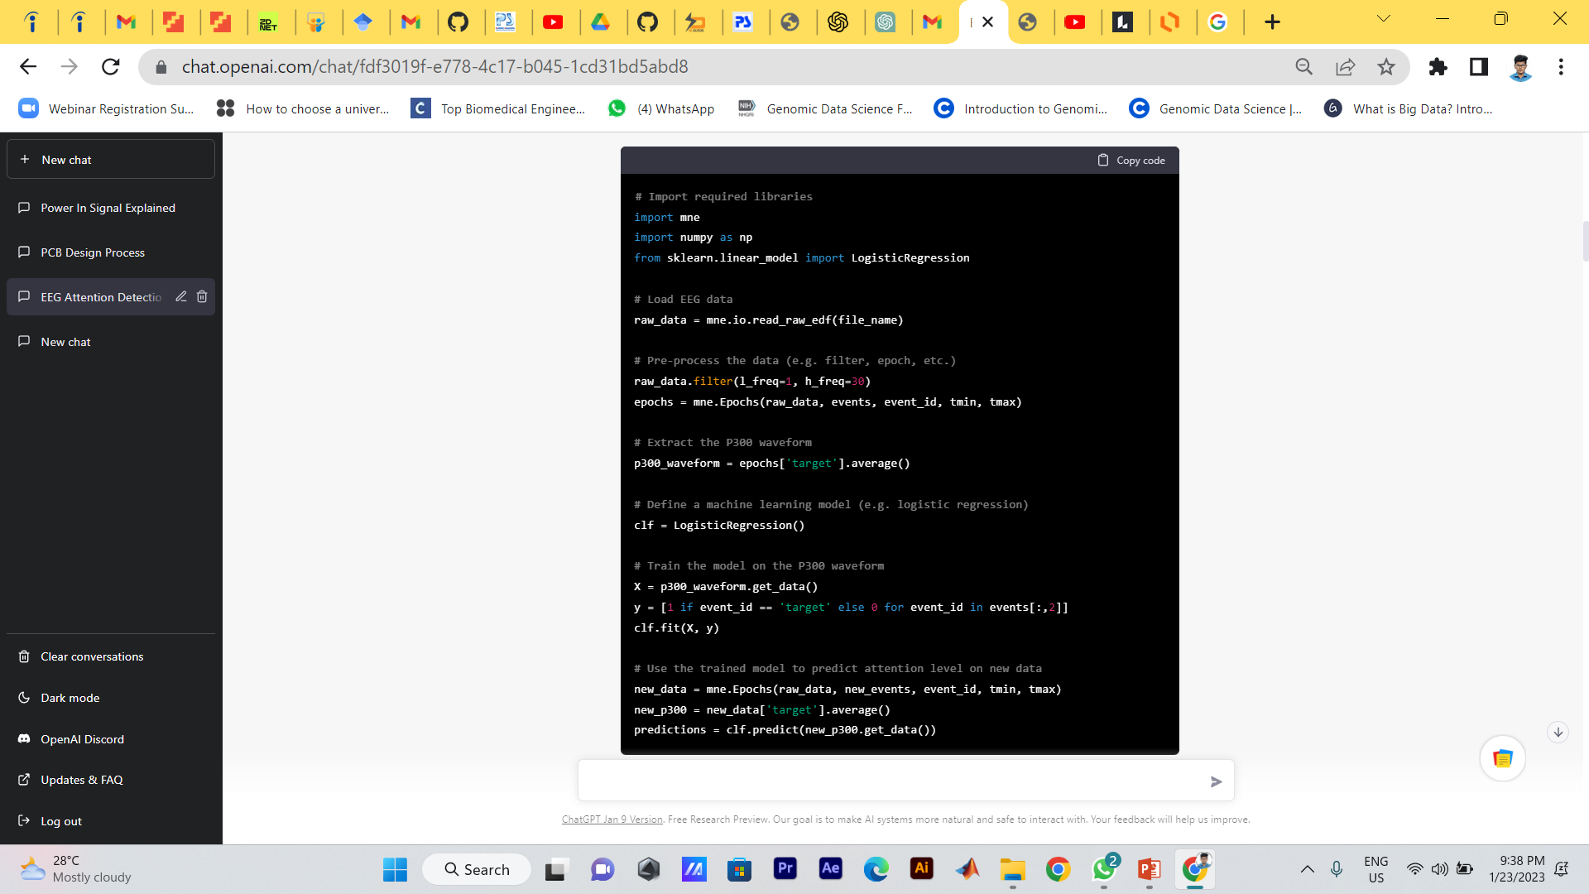
Demonstration (Brain Computer Interface – Basic Architecture)

Slide 20
Novalty

Slide 21
WORK PLAN
S.NO | WEEK PLAN | OCTOBER 4TH WEEK | NOVEMBER 4TH WEEK | DECEMBER 4TH WEEK | JANUARY 4TH WEEK
1 | LITERATURE REVIEW
2 | CHECK THE AVAILABILTY OF SOFTWARE PRODUCTS
3 | PRELIMINARY OF DATASET
4 | IMPLEMENTATION OF PROJECT

Slide 22
REFERENCES
[1] Mitra Alirezaei, Sepideh Hajipour Sardouie “Detection of Human Attention Using EEG Signals”
2017. 2nd International Iranian Conference on Biomedical Engineering.
[2] Mahnaz Arvaneh, Ian H. Robertson and Tomas E. Ward “A P300-Based Brain-Computer Interface for Improving Attention” 2019.
[3] Jonghyuk Park, Jonghun Park, Dongmin Shin and Yerim Choi “A BCI Based Alerting System for Attention Recovery of UAV Operators” 2021.
[4] Muhammad Bilal, Muhammad Marouf, Safdar Rizvi, Fatima Bashir, Muhammad Shahzad, Jawad Ahmed Bhutta “EEG-Based BCI for Attention Assessment in E-Learning Environment using SVM” 2022.
[5] J. Katona1 , A. Kovari “Examining the Learning Efficiency by a BrainComputer Interface System”2018.

Slide 23
REFERENCES
[6] Sun, H., Bi, L., Chen, B., & Guo, Y. (2015). EEG-based Safety Driving Performance Estimation and Alertness Using Support Vector Machine. International Journal of Security and Its Applications, 9(6), 125-134.
[7] Dehais, F.; Lafont, A.; Roy, R.; Fairclough, S. A neuroergonomics approach to mental workload, engagement and humanperformance. Front. Neurosci. 2020, 14, 268.
[8] Molloy, K.; Griffiths, T.D.; Chait, M.; Lavie, N. Inattentional deafness: Visual load leads to time-specific suppression of auditoryevoked responses. J. Neurosci. 2015, 35, 16046–16054.
[9] Di Flumeri, G.; Aricò, P.; Borghini, G.; Sciaraffa, N.; Di Florio, A.; Babiloni, F. The dry revolution: Evaluation of three differentEEG dry electrode types in terms of signal spectral features, mental states classification and usability. Sensors 2019, 19, 1365.
[10] Choi, Y.; Park, J.; Shin, D. A semi-supervised inattention detection method using biological signal. Ann. Oper. Res. 2017,258, 59–78.

Slide 24
REFERENCES
[11] Dehais, F.; Duprès, A.; Blum, S.; Drougard, N.; Scannella, S.; Roy, R.N.; Lotte, F. Monitoring pilot’s mental workload using ERPsand spectral power with a six-dry-electrode EEG system in real flight conditions. Sensors 2019, 19, 1324.
[12] Chaudhuri, A.; Routray, A. Driver fatigue detection through chaotic entropy analysis of cortical sources obtained from scalp EEGsignals. IEEE Trans. Intell. Transp. Syst. 2019, 21, 185–198.
[13] Gonsalvez, C. J., and Polich, J. (2002). P300 amplitude is determined by target-totarget interval. Psychophysiology 39, 388–396.
[14] Attention https://en.wikipedia.org/wiki/Attention
[15] Wang, J. R., and Hsieh, S. (2013). Neurofeedback training improves attention and working memory performance. Clin. Neurophysiol. 124, 2406–2420.

